Slide 1
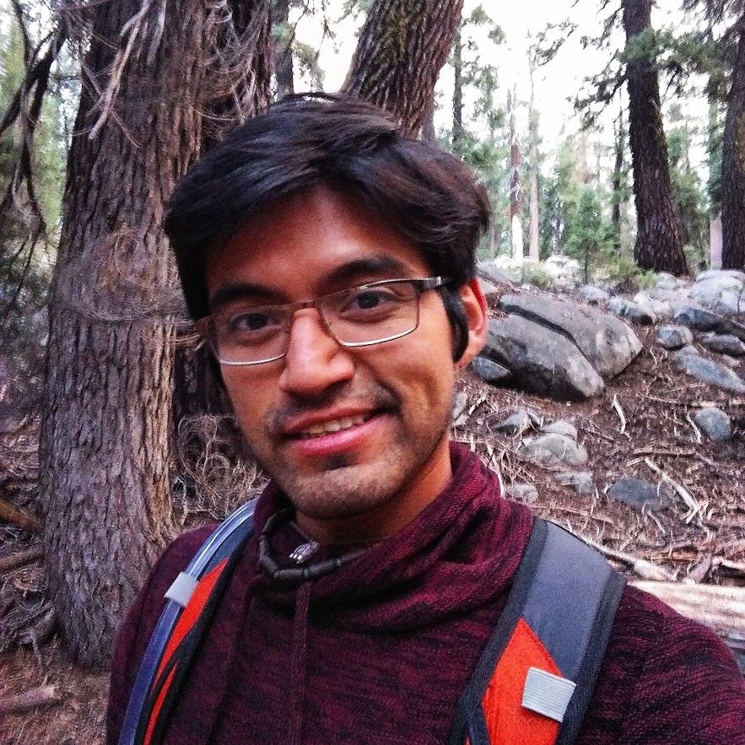
Martin Mendez Ruiz
Current Semester: 2nd semester Digital Engineering
Past Studies: B.Sc. Telecommunications Engineering
Skills:
Programming skills: Java, Python, C++, basic HTML and CSS.
1 year of project work experience
Personal Motivation
Improve and put in practice my programming skills
Get to know the steps to create a software product
Learn project management skills

Slide 2
For Blog
I always wanted to develop an app and I believe this course will help me recall all my programming skills acquired so far and put it in practice to create a good software product. I also want to learn the basics of project management for Software engineers because I thing this is something that, as computer science, you must know.

